Slide 1

Team Name : SheCode Squad
Team Members : Navneet, Priya and Isham

Slide 2
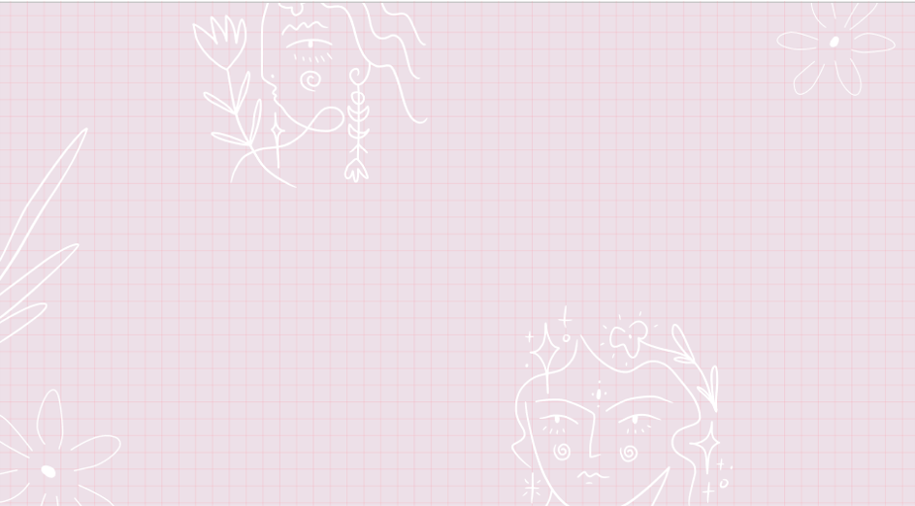
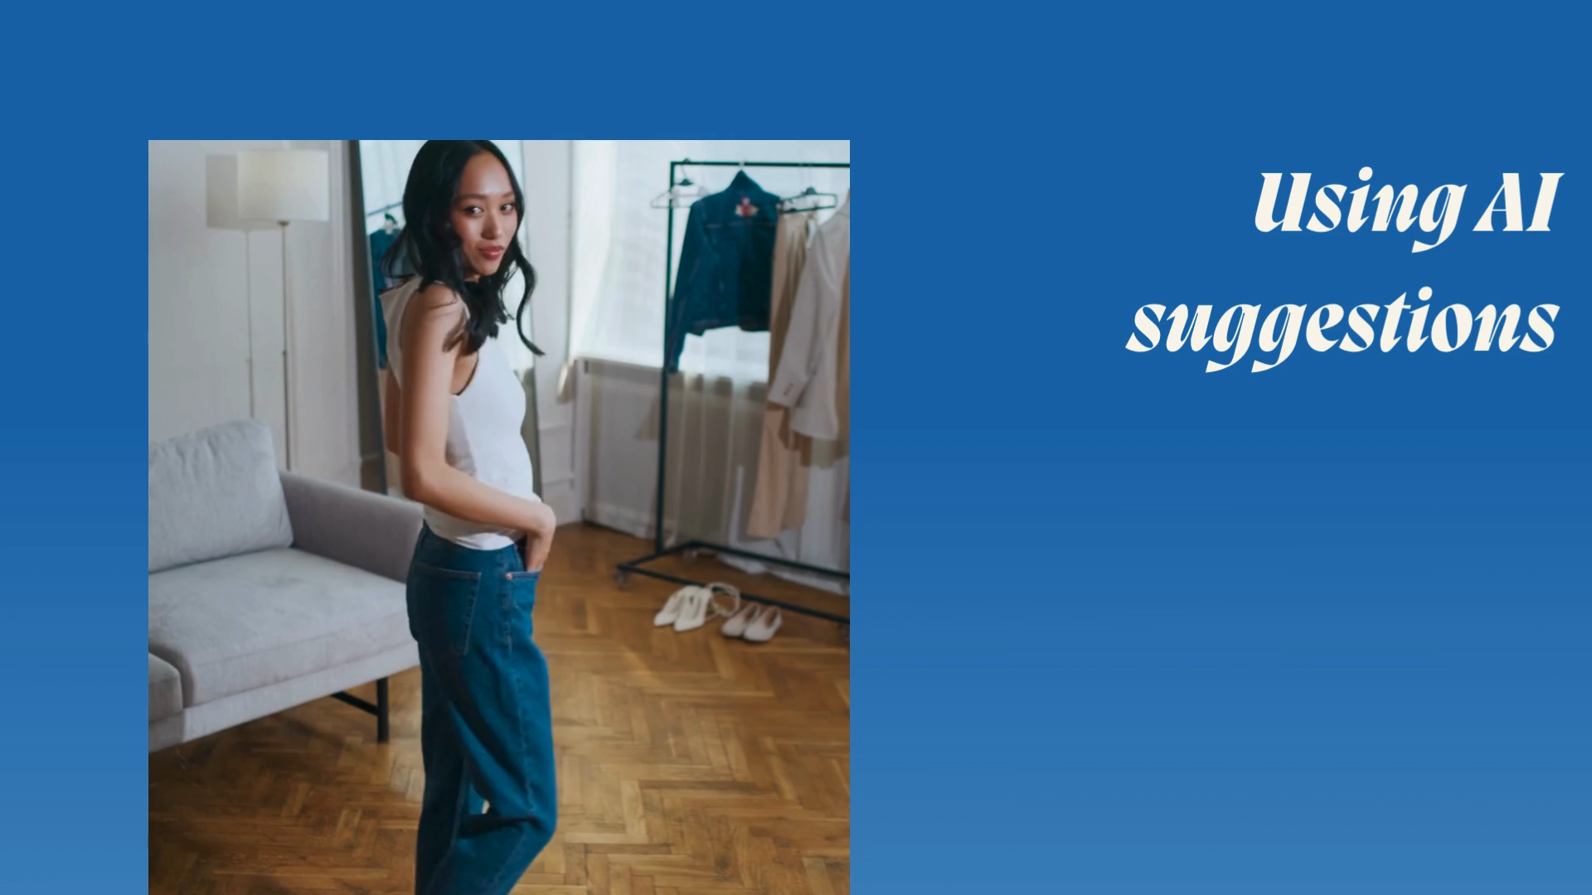
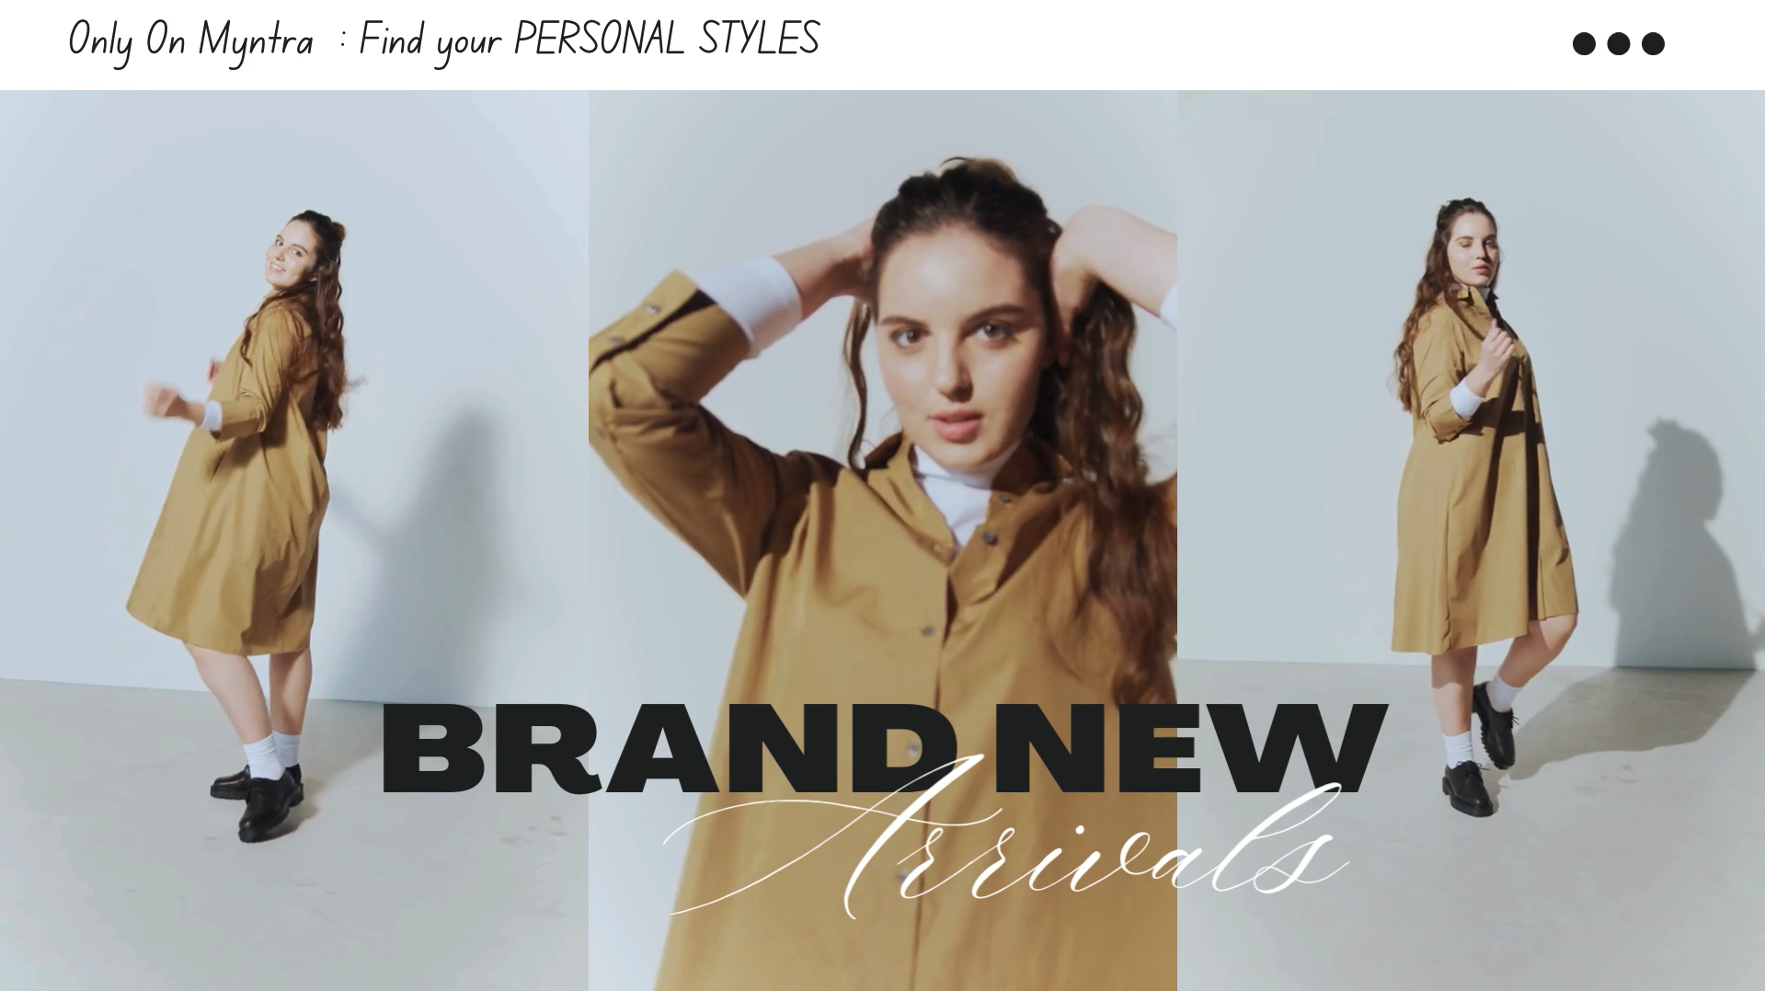
Trend-Centric
Recommendations
Aim: To make Myntra more interactive and updated with the latest trends, user preferences and AI tools.

Slide 3
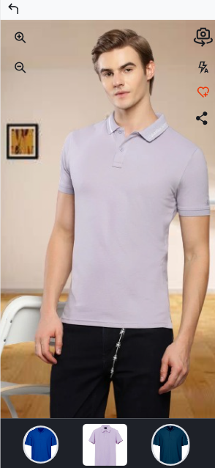
3 D Try On
The 3D Try On allows users to virtually try on clothing items using augmented reality (AR).
It provides a realistic preview of how the outfit will look in terms of color, texture, and overall style.
Using a smartphone or webcam, the feature overlays the chosen clothing item onto the user's live video feed or a static image of themselves.

Slide 4
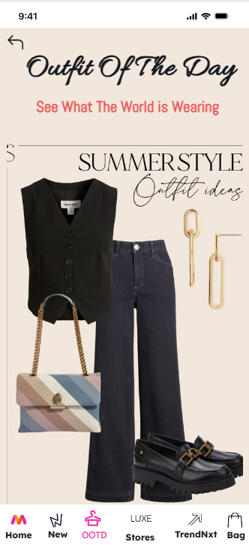
Outfit of The Day
A page where users can view an outfit each day based on the ongoing fashion trends. The OOTD is a versatile combination for various occasions and easy to put together with items you likely already have in your wardrobe!

Slide 5
Benefits
Virtual Try On helps users make more confident purchasing decisions by visualizing how clothes will look on them.
It also minimizes the chances of returning items due to sizing or style mismatch.
OOTD creates opportunities for interaction, discussions about style, and the sharing of fashion tips and advice.
OOTD also allows followers to discover new brands and products they might want to purchase for themselves.

Slide 6
Thank You !

